Slide 1
OpenEPCIS Cloud-Native EPCIS / CBV 2.0
Sven Böckelmann | benelog GmbH & Co. KG

Slide 2




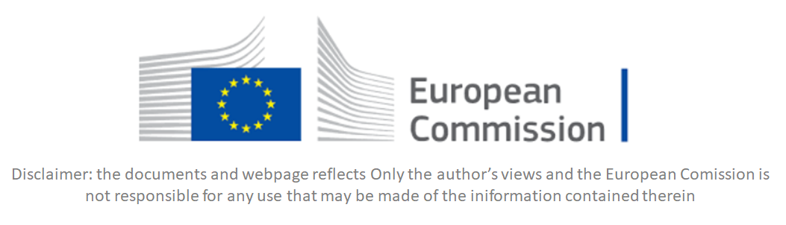
Introduction

Slide 3

Contact
Sven Böckelmann Head of Software Development Co-Chair of the EPCIS 2.0 GSMP
benelog GmbH & Co. KG
Bahnhofstr. 11 50169 Kerpen Germany
Phone + 49 (0) 160 844 06 00 E-Mail sven.boeckelmann@benelog.com

Slide 4
Agenda
Time | Topic
09:30 | Welcome
09:45 | GS1 Standards and EPCIS 2.0
10:15 | EPCIS Event Structure
11:00 | Coffee Break
11:15 | EPCIS RESTful API
12:30 | Lunch Break
13:30 | Introduction to JSON Linked Data in EPCIS 2.0
14:15 | Extend EPCIS 2.0 Events using the GS1 Web Vocabulary
14:45 | Coffee Break
15:00 | Hot to create a User-Defined Custom EPCIS 2.0 Extension
15:30 | Work on provided example use-cases
16:45 | Feedback and next steps
17:00 | End of Session

Slide 5
GS1 Standards and EPCIS 2.0

Slide 6



Food Safety And Authenticity
Zukunftslabor2030
FreshTwin

Slide 7

GS1 Standards
How GS1 standards work
GS1 standards create a common foundation for business by uniquely identifying, accurately capturing and automatically sharing vital information about products, locations, assets and more. Businesses can also combine different GS1 standards to streamline business processes such as traceability.
© GS1 Global
https://www.gs1.org/standards/how-gs1-standards-work#:~:text=GS1%20standards%20create%20a%20common,business%20processes%20such%20as%20traceability.
Identify
Capture
Share
Use

Slide 8
GS1 General Specifications
The foundational GS1 standard that defines how identification keys, data attributes and barcodes must be used in business applications.
https://ref.gs1.org/standards/genspecs/

Slide 9
EPCIS – GS1 standard for “sharing”
Enables data-carrier neutral sharing of supply chain visibility data
Also published as ISO/IEC 19987
Defines a framework data model, capture and query interfaces
Business process steps are captured as “events”, which indicate:
What objects are the subject of event?
When did this event take place?
Where did the event occur, and where are the objects thereafter?
Why did the event take place?
How (warm, humid, fast, radioactive, etc.) are the objects?
EPCIS 2.0: New features to increase versatility, lower adoption hurdles
Notes:
9
How Dimension is new in EPCIS 2.0

Slide 10
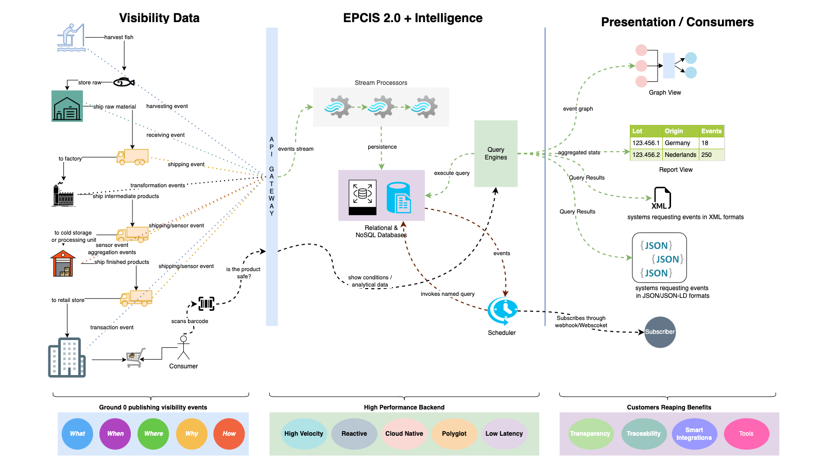

Slide 11
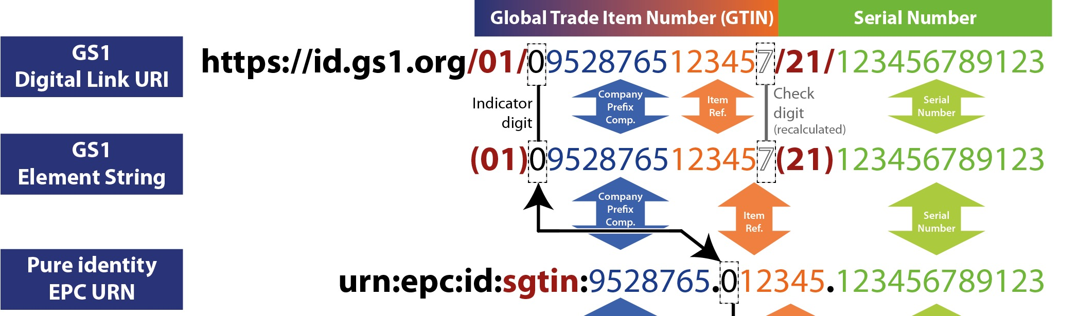
GS1 Digital Link URIs in EPCIS 2.0
GS1 Digital Link URIs are easily encoded from barcoded GS1 element strings, without the complexity required to encode EPCs:
No need to displace the leading digit
No need to remove the check digit
No knowledge of GCP length required (!)
EPCIS 2.0
EPCIS 1.2

Slide 12
GS1 Linked Data Example URLs
Links available for this product
https://id.gs1.de/01/04012345999969?linkType=all
The logistic unit‘s status
https://id.gs1.org/00/040123451111111110
?linkType=gs1:traceability
Notes:
Ralph Tröger is the man!

Slide 13
OpenEPCIS – GS1 EPCIS Standard in Perfection
All required backend dependencies are 100% open source.
Designed for resilience and scalability by using latest cloud-native technologies.
Full implementation of the EPCIS / CBV 2.0 Standard.
Validation and active bi-directional conversion between EPCIS 1.2 and 2.0 messages.
Complete, transparent support of EPCIS 2.0 and 1.2 allows seamless integration of existing implementations.
Based on more than 10 years of experience in operating large scale EPCIS solutions.

Slide 14















Tech Stack - EPCIS 2.0 Repository
available for
and many more

Slide 15

Cloud Native - Quarkus
reactive applications
Reactive System Design
event-driven architecture
responsive
resilient
elastic
message driven
HTTP Microservices
serverless deployments
reactivemanifesto.org

Slide 16
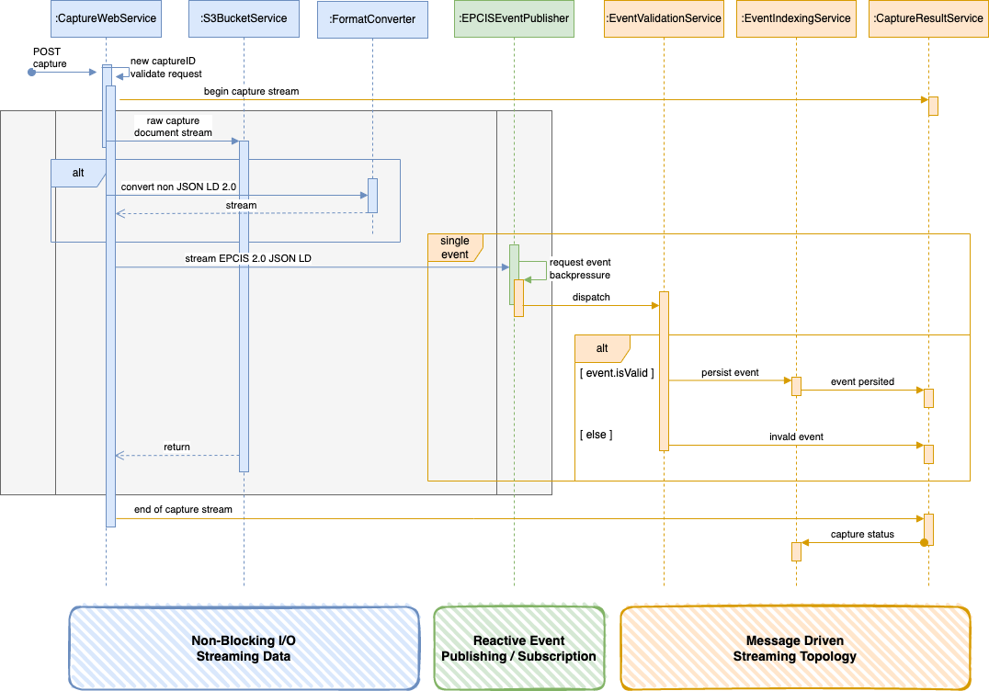
Capture Sequence Diagram

Slide 17
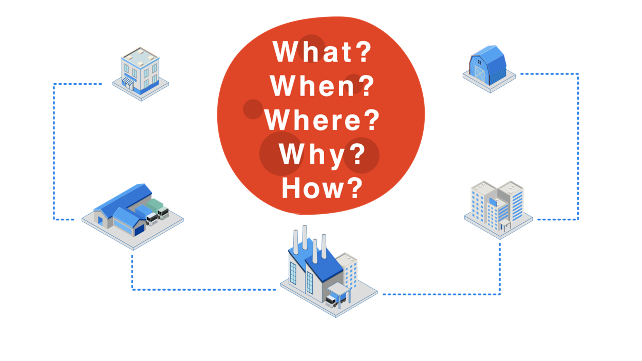
OpenEPCIS Toolbox
Integrations
GS1 Standards
EPCIS Repository
EPCIS Core Modules
Testdata Generator
Micrometer Profiling
GS1 DigitalLink
Web Services
Constants
EPCIS EventHash
Capture
Bill of Materials
EPCIS 1.2 XML
Subscribe
Converter
JSON-LD XML
Query
Model
Messaging

Slide 18
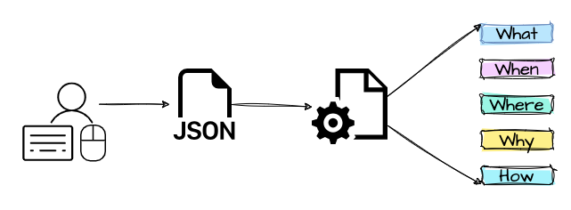
EPCIS Event Structure

Slide 19
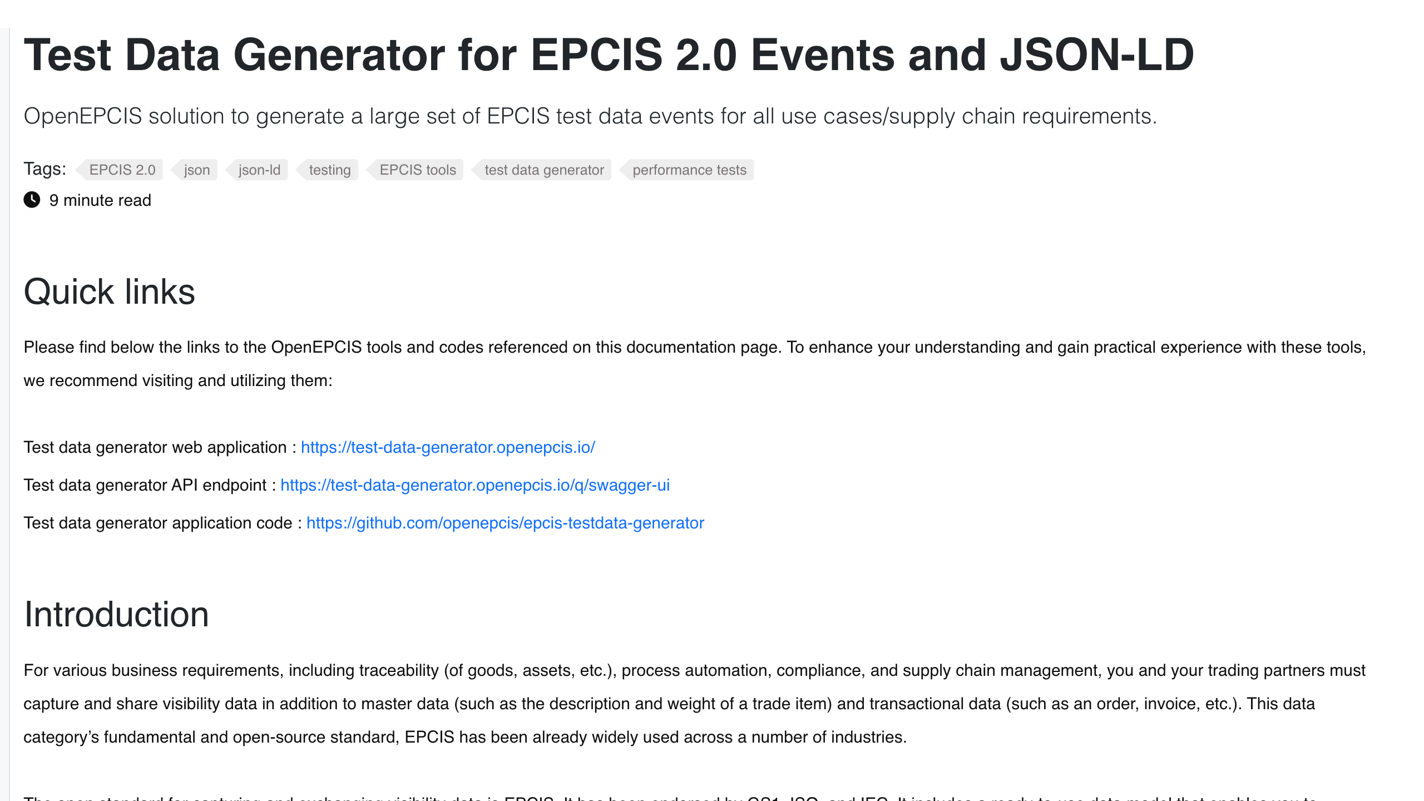
Testdata Generator Documentation
https://openepcis.io/docs/test-data-generator/

Slide 20
EPCIS RESTful API

Slide 21
Online Training Resources
https://github.com/MEDIFIT-PRIMA/inat-epcis-workshop
Preparation
GIT client
Postman
IDE / Coding Environment
Create user accounts on epcis.openepcis.cloud

Slide 22
GS1 EPCIS GitHub Resources
https://github.com/GS1/EPCIS/
https://github.com/gs1/EPCIS/tree/master/REST%20Bindings
OpenEPCIS Cloud REST
https://epcis.openepcis.cloud/q/swagger-ui/index.html

Slide 23
Introduction to JSON Linked Data in EPCIS 2.0

Slide 24
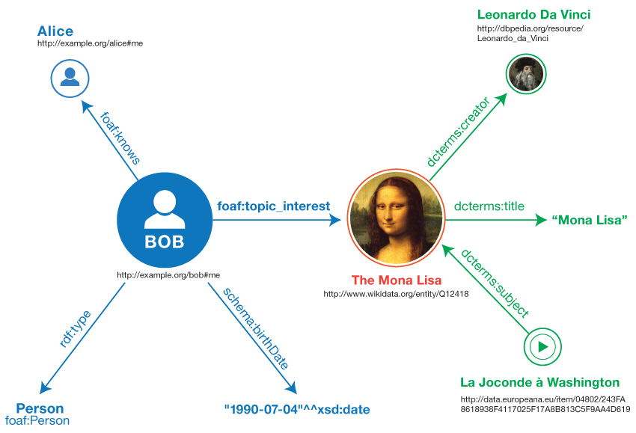
EPCIS 2.0 – JSON-LD and RDF to support semantic web applications
Web URIs also play a crucial role in the Resource Description Framework
- RDF -
= “a framework for representing information in the Web”
RDF’s core principle:
graphs, consisting of subject-predicate-object triples
[© W3C 2014, https://www.w3.org/TR/rdf11-primer/]
Notes:
Ontologies
Dublin core (dcterm), purl,,,

Slide 25
GS1 EPCIS Artefacts
https://ref.gs1.org/standards/epcis/artefacts
JSON-LD Playground
https://json-ld.org/playground/

Slide 26
Extend EPCIS 2.0 Events using the GS1 Web Vocabulary

Slide 27
GS1 Web Vocabulary
https://www.gs1.org/voc/
JSON Schema Validator
https://www.jsonschemavalidator.net/

Slide 28
Hot to create a User-Defined Custom EPCIS 2.0 Extension

Slide 29
Required Steps for User-Defined Extensions
Create JSON Schema
Register JSON Schema in OpenEPCIS Repository
Create Website for describing custom ontology (optional)

Slide 30
Work on provided example use-cases

Slide 31
Feedback and talk about next steps

Slide 32
THANK YOU!

